Slide 1

Armed Forces College of Medicine
AFCM

Slide 2
Viral Hepatitis Acute and Chronic
By: Amira Isaac Samaan

Slide 3
Indented Learning Outcomes (ILOs)
By the end of this lecture the student will be able to:
Define acute Hepatitis
Identify etiology of acute hepatitis
Diagnose patient with acute hepatitis
Decide what Investigation needed in case of acute hepatitis
Determined treat schedule for patient with acute hepatitis

Slide 4
Background
Hepatitis: inflammation of liver irrespective the cause
Acute Viral Hepatitis: symptoms last less than 6 months
Chronic Hepatitis: Inflammation of liver lasts longer than 6 months
Cirrhosis: Irreversible replacement of liver tissue by fibrosis, scar tissue

Slide 5
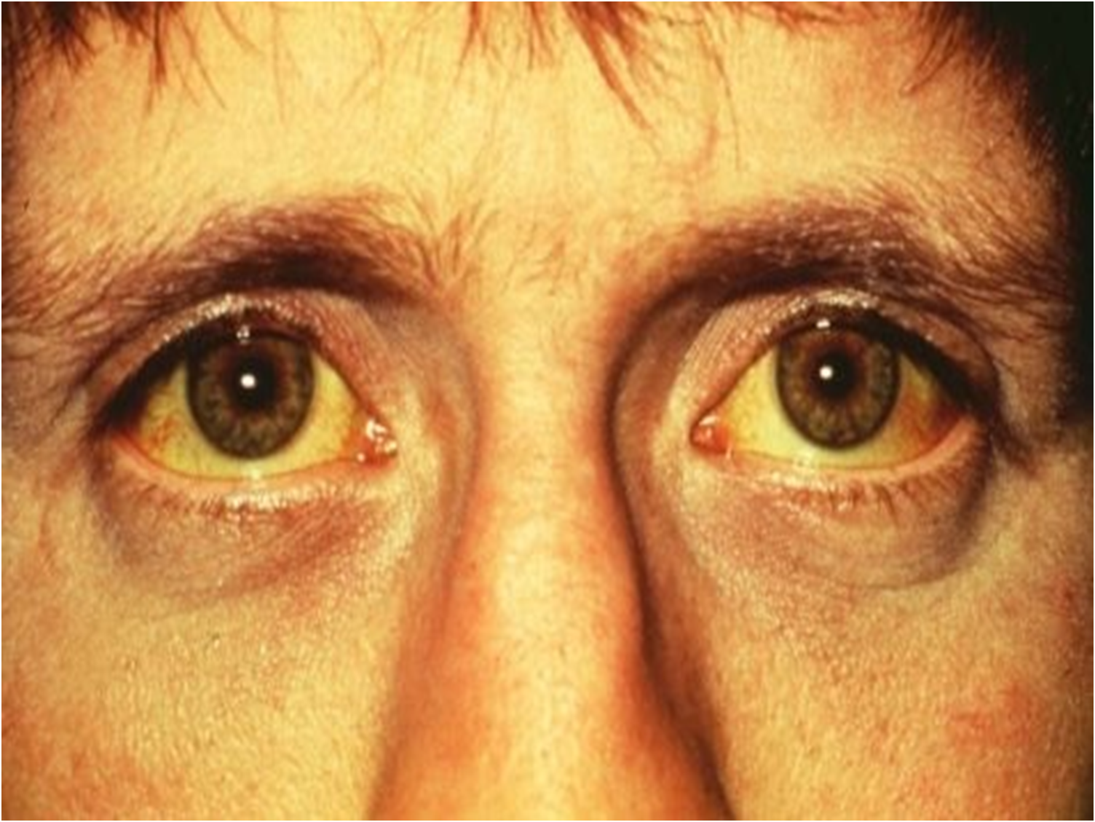
Acute hepatitis

Slide 6
Causes for Acute Hepatitis
Infection
Viral
Hepatotropic viruses
- Hepatitis A,B,C,D,E
Non Hepatotropic viruses
- Estein Barr virus,
- Cytomegalo virus,
- Adenovirus
- Herpes Simplex virus
Toxins
Alcohol
Drugs (Isoniazid,Halothane)
Other causes:-
Wilson’s disease, Autoimmune disease, Ischemic hepatitis

Slide 7
Pathophysiology
The hepatocellular damage caused in acute viral hepatitis is not due to direct viral injury but rather due to the immune response.
Activated immune cells of patients with viral hepatitis destroy hepatocytes.
Consequently, patients with weak immune systems such as children and immunocompromised patients may not develop any symptomatology.
In these groups infection may only be detectable by laboratory markers.

Slide 8
Clinical Stages
The classic presentation involves four phases:
- Phase 1: Incubation period (viral replication phase)
- Phase 2: Prodromal (pre-icteric) phase
- Phase 3: Icteric phase
- Phase 4: Convalescent phase

Slide 9
Incubation period (viral replication phase)
All the Hepatitis Viruses possess an incubation period, which is the time between exposure to virus and onset of disease. The incubation periods vary for each virus but generally last between one to two months.
Patients are asymptomatic. The virus multiplies and spreads without causing symptoms.

Slide 10
Prodromal (pre-icteric) Phase
Patients experience multiple systemic non-specific symptoms like fever, anorexia, nausea, vomiting, alterations in taste, arthralgias, malaise, fatigue, urticaria, and pruritus.
when seen by a healthcare provider during this phase, patients are often diagnosed as having gastroenteritis

Slide 11
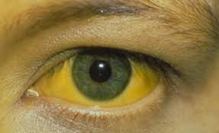
Icteric Phase
At this stage Patients may note dark urine, followed by pale-colored stools; in addition to the predominant gastrointestinal symptoms and malaise,
One to five days later patients become icteric (develop jaundice) and may develop right upper quadrant pain with hepatomegaly

Slide 12
Icteric Phase
Liver is enlarged, tender
Cervical adenopathy(10-20%)
Splenomegaly(10-20%)
Fever is absent
Encephalopathy :Irritability Letargy, confusion

Slide 13
Convalescent phase
Symptoms and jaundice resolve
Liver enzymes return back to normal.

Slide 14
Physical examination
Physical findings vary with the type of hepatitis and the time of presentation.
Patients often present with low-grade fever. Those experiencing significant vomiting and anorexia may show signs of dehydration, such as tachycardia, dry mucous membranes, loss of skin turgor, and delayed capillary refill.

Slide 15
Physical examination
Patients in the icteric phase may have yellowish discoloration of the sclerae or mucous membranes, skin or discoloration of the tympanic membranes.
In viral hepatitis, the liver may be tender and diffusely enlarged with a firm, sharp, smooth edge.

Slide 16
Hepatitis A Virus
The incubation period : 2-7 weeks (average 28 days).
Mode of transmission: Feco-oral route
HAV IgM : positive at the time of onset of symptoms; results remain positive for 3-6 months after the primary infection
HAV IgG: appears soon after IgM and generally persists for many years.
The role with HAV is complete resolution, no chronicity.

Slide 17
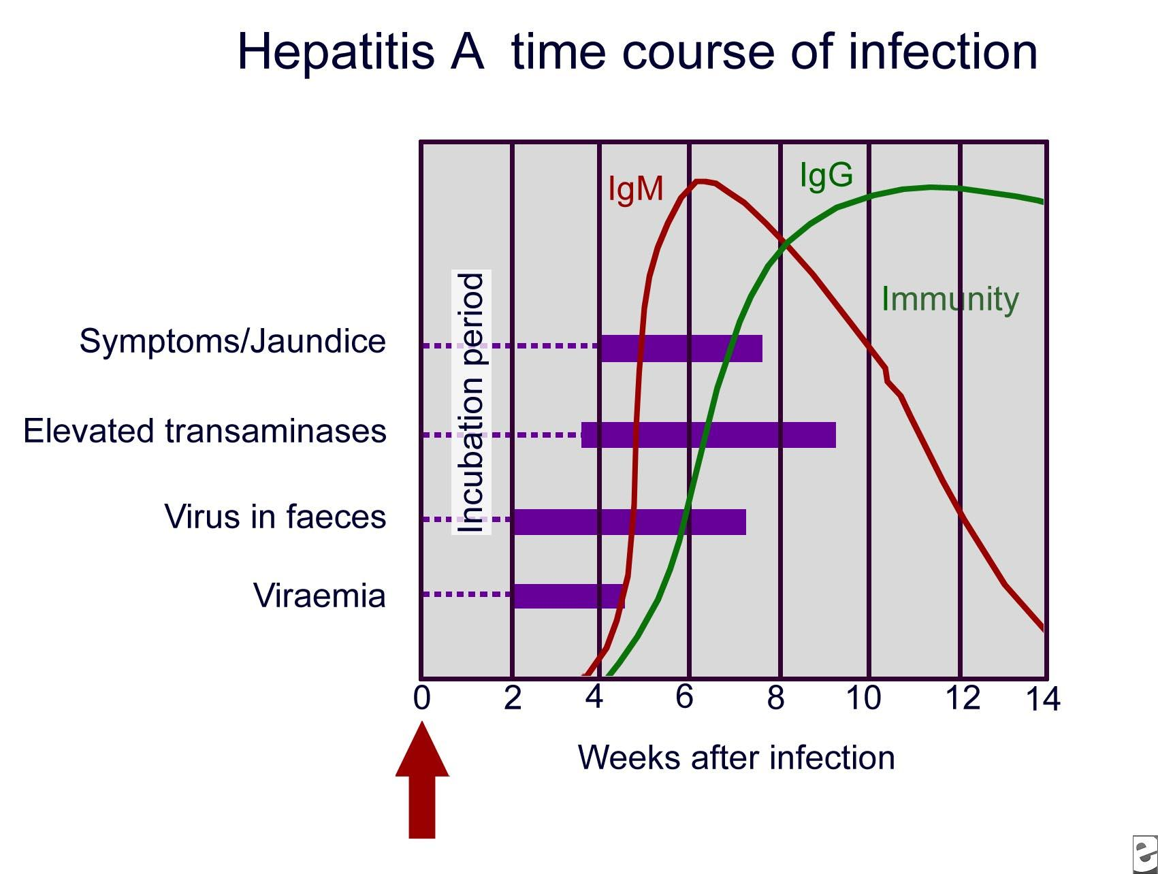
Hepatitis A Virus

Slide 18
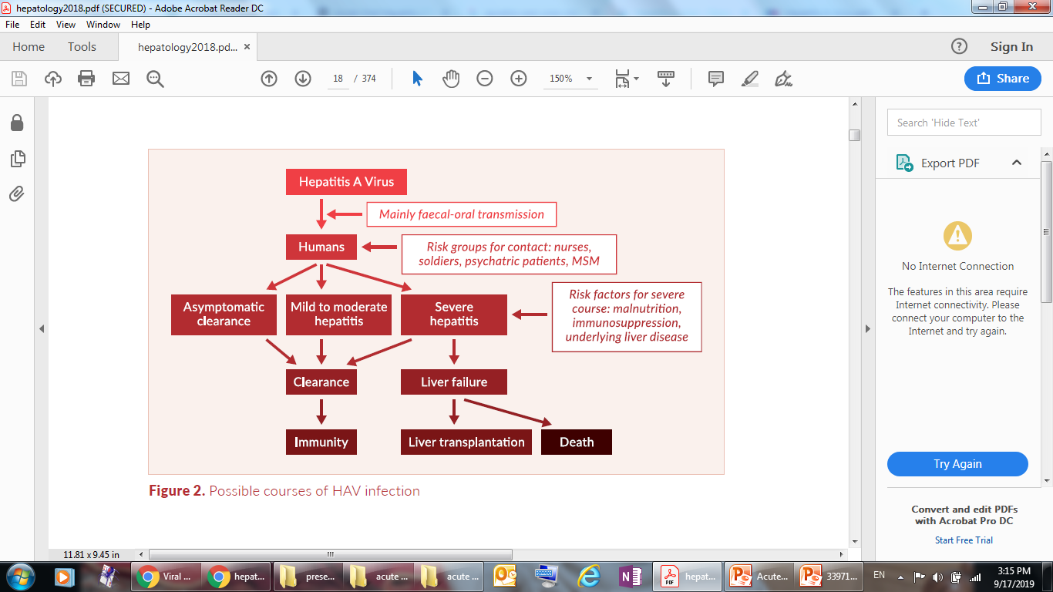
Hepatitis A Virus

Slide 19
Hepatitis B Virus
The incubation period: 30-180 days (average 75 days).
Mode of transmission: Blood borne, tattooing, piercing, perinatal, sexually.
Clinical course: is highly variable where Some patients experience rapid improvements, others go on to experience prolonged disease with slow resolution.
Others may have symptoms that periodically improve, only to worsen later (relapsing hepatitis).
In a subset of patients the disease rapidly progresses to fulminant liver failure; this may occur over days to weeks.

Slide 20
Hepatitis B Virus
HBsAg
Present in acute of chronic infection
Detectable 1 to 2 weeks after infection
HBeAg
Appears shortly after HBsAg
Indicates viral Replication and Infectivity
HBsAb (Anti-HBs)
Present after vaccination or clearance of HBsAg(Usually 1 to 3 months)
Indicates immunity to HBV
HB core Antibody (IgM anti-HBc or IgG anti-HBc)
Only Serological marker of HBV during "Window Period“
HBV-DNA
indicates active replication of virus.

Slide 21
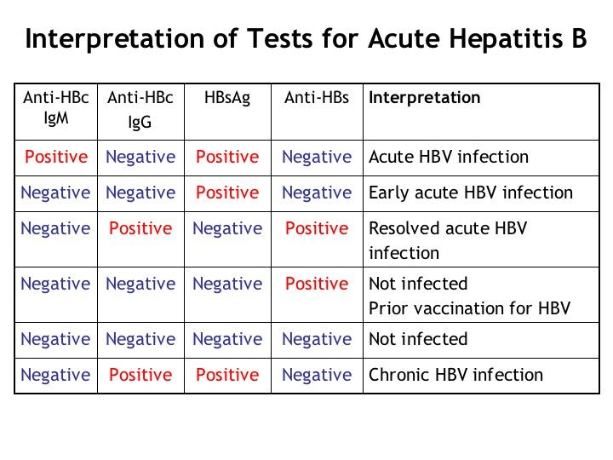
Hepatitis B Virus

Slide 22
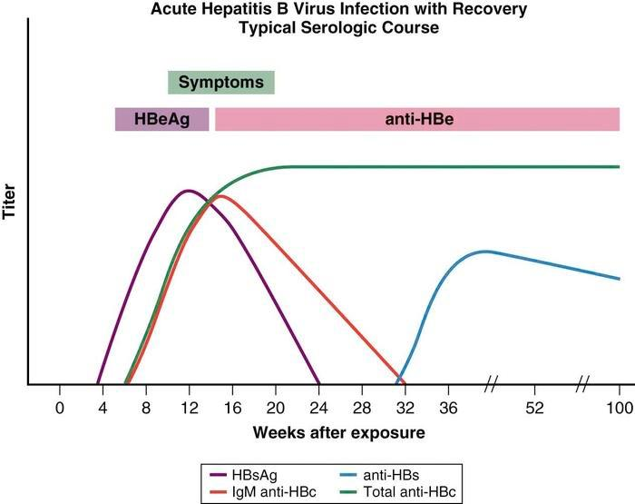
Hepatitis B Virus

Slide 23
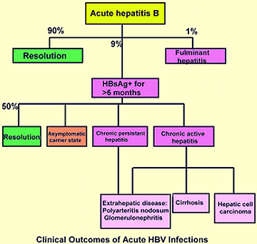

Slide 24
Hepatitis C Virus
The incubation period : 15-150 days.
80% of cases are asymptomatic and do not develop Icterus.
Mode of transmission: exposure to infected blood, transfusion of HCV-contaminated blood and blood products, contaminated injections during medical procedures, and through injection drug use
HCV Ab
- Can’t distinguish acute from chronic infection
- May appear 3 - 5 months after infection
HCV (PCR)
- Detect viral RNA
- Appear 1-2 weeks after infection

Slide 25
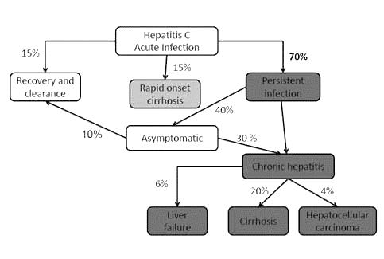

Slide 26
Hepatitis D Virus
Incubation period :35 days.
Hepatitis D only occurs in people who are infected with the hepatitis B virus because HDV is an incomplete virus that requires the helper function of HBV to replicate.
Patients simultaneously infected with HBV and HDV often have an acute, self-limited infection. Fewer than 5% of these patients develop chronic HDV infection (better prognosis).

Slide 27
Hepatitis D Virus
Chronic HBV carriers who become superinfected with HDV tend to have a more severe acute hepatitis; 80% of these patients go on to develop chronic HDV infection which may lead to fulminant acute hepatitis and severe chronic active hepatitis with progression to cirrhosis (worse prognosis).
Over the long term, as many as 70-80% of these patients have evidence of chronic liver disease with cirrhosis, compared with only 15-30% of patients with chronic HBV alone.

Slide 28
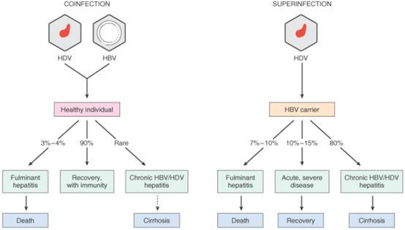

Slide 29
Hepatitis E Virus
Incubation period: 2-9 weeks (average 45 days).
Mode of transmission: Feco-oral by contaminated water
HEV usually causes an acute self-limited disease like HAV infection.
Fulminant disease occurs in about 10% of cases.
In women who are pregnant, HEV infection has a case-fatality rate of 15-20%.
No reports exist of chronic infection with HEV.
Anti-HEV antibodies:
IgM (acute)
IgG (chronic)

Slide 30
Investigations: Biochemical tests
* Serum Amino-transferases: Marked elevation of serum transaminases, ALT elevated more than AST, typically ≥ 400.
* Serum bilirubin: Total bilirubin may be elevated in infectious hepatitis. Bilirubin levels higher than 30 mg/dL indicate much severe disease.
* Alkaline phosphatase: usually in the reference range but may elevate to no higher than twice the normal level. If ALP is elevated significantly, consider liver abscess or biliary obstruction causing cholestasis.
* Prothrombin time (PT): if prolonged it is a grave finding that indicates impaired synthetic function of the liver.
* Albumin: show no decrease in acute hepatitis, while a decline is expected in chronic hepatitis

Slide 31
Investigations: Serological tests
HAV: HAV IgM
HBV: HBsAg, HBc IgM and HB DNA by PCR
HCV: HCV Ab and HCV RNA by PCR
HDV: HDV IgM
HEV: HEV IgM
If all tests for viral hepatitis are negative, other viruses should be expected like CMV or EBV….
Autoimmune markers: (ANA,AMA,ASMA,LKM)
Cu, Serum Ceruloplasmin

Slide 32
Investigations: Imaging
Radiologic studies may be useful in all stages of hepatitis B infection.
Ultrasonography may show hepatomegaly in acute hepatitis, also hepatic vein duplex for acute budd chiari syndrome

Slide 33
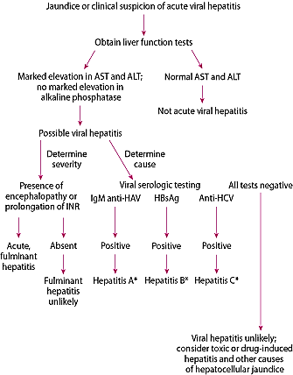

Slide 34
Treatment
Supportive management
No treatments attenuate acute viral hepatitis.
Alcohol should be avoided because it can increase liver damage.
Light palatable compensated meals
Restrictions on diet or activity, including commonly adviced bed rest, have no scientific basis.
Patient isolation or hospitalization is rarely necessary.
For cholestatic hepatitis, cholestyramine 8 g po once/day or bid can relieve itching.
Specific therapy
Antivirals may be considered for HBV & HCV
Specific treatment (Autoimmune, Wilson)
Liver transplantation for Fulminant hepatitis

Slide 35
Prevention
Because treatment have limited efficacy, prevention of viral hepatitis is very important.
Good personal hygiene helps prevent transmission, particularly feco-oral transmission, as with HAV and HEV
Immunoprophylaxis can involve active immunization using vaccines and also passive immunization. Vaccines for HAV and HBV are available, also a vaccine for HEV is available in some countries.
No product exists for immunoprophylaxis of HCV or HDV. However, prevention of HBV infection prevents HDV infection.

Slide 36
Prognosis of Acute Hepatitis
Initial presenting features such as Ascites, peripheral Edema, and symptoms of hepatic Encephalopathy suggest a worse prognosis.
In addition, a Prolonged PT, Low-serum Albumin level, Hypoglycemia, and very high-serum Bilirubin values suggest severe hepatocellular disease.
Patients with these clinical and laboratory features deserve prompt hospital admission

Slide 37
Prognosis of Acute Hepatitis
- Resolution
- Chronic hepatitis
- Fulminant hepatitis
- Cirrhosis
- Hepatocellular carcinoma

Slide 38
Complications
Depend on the identity of the infectious agent along with the immune response of the host.
Chronic Viral Hepatitis:
- Hepatitis A Virus: Never occurs.
- Hepatitis B Virus: Occurs infrequently in adults but frequently in children and immunocompromised patients.
- Hepatitis C Virus: Occurs in majority of the cases.

Slide 39
Fulminant Hepatitis
Is a rare syndrome of massive necrosis of liver parenchyma and a decrease in liver size
Catastrophic complication of acute viral infection and occurs when the immune response becomes over-exuberant
Hepatitis A Virus: Rare but possible.
Hepatitis B Virus: Occurs in a small minority of cases but increased risk during concomitant Hepatitis D Virus.
Hepatitis C Virus: Almost never occurs.

Slide 40
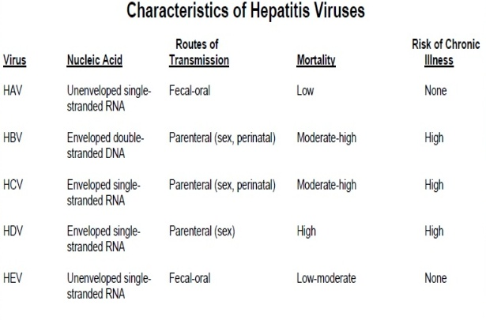
Summary

Slide 41
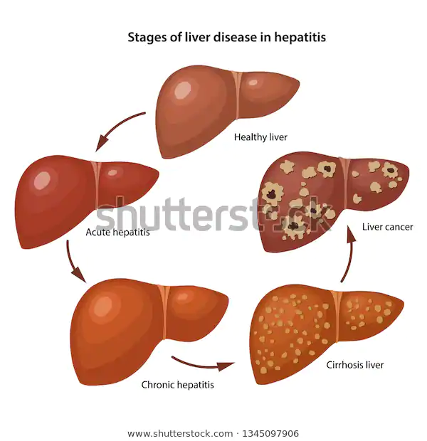
Chronic Hepatitis

Slide 42
Chronic Hepatitis B Virus
Factors that increase risk of progression to chronicity:
Male sex
Old age
Alcohol use
Family history of HCC
Persistantly elevated levels of HBV DNA and ALT
Elevated Alpha-feto Protein
Co- infection with HDV, HCV or HIV

Slide 43
Chronic Hepatitis B Virus
People with Chronic HBV infection require medical evaluation and regular monitoring to determine disease progression
Also to help early identification of Hepatic necro-inflammation, cirrhosis or possibility of HCC due to viral oncogenicity

Slide 44
Chronic Hepatitis B Virus
Several antivirals are available for chronic HBV infection:
- Lamivudine
- Entecavir
- Tenofovir
- Telbivudine
- Adefovir
- Interferon alfa-2b
- Pegylated interferon alfa-2a

Slide 45
Chronic Hepatitis C Virus
Long-term natural history of HCV infection is highly variable
Chronic HCV infection is accompanied by
Extrahepatic manifestations reported in up to 75% of patients, including:
Mixed cryoglobulinaemia vasculitis, renal disease (elevated creatinine), type 2 diabetes, cardiovascular disease (vasculitis, arterial hypertension), porphyria cutanea tarda, lichen planus and lymphoproliferative disorders
Non-specific symptoms: fatigue, nausea, abdominal pain, weight loss
Rapid development of hepatic fibrosis and accelerated time to cirrhosis
Increased risk for liver failure, HCC and liver-related mortality

Slide 46
Goal of Chronic HCV Treatment
The Main goal in HCV treatment is undetectable serum or plasma HCV RNA by sensitive assay 12 weeks (SVR12) or 24 weeks (SVR24) after end of treatment (EOT)
The Goal to cure HCV infection is important to
Prevent the complications of HCV-related liver and extrahepatic diseases, including Hepatic necroinflammation, fibrosis, cirrhosis, decompensation of cirrhosis, HCC and death
Improve quality of life and remove stigma
Prevent onward transmission of HCV

Slide 47
Goal of Chronic HCV Treatment
Sustained virological response (SVR) corresponds to a definitive cure of HCV infection in nearly all cases and is frequently associated with
Improvement in extrahepatic manifestations
Improvement/disappearance of liver necroinflammation and fibrosis
Regression of advanced hepatic fibrosis (F3) or cirrhosis (F4)
Reduced risk of HCC, hepatic decompensation, overall mortality, and liver transplantation
HCV therapy is one of the interventions necessary to reduce global burden of disease

Slide 48
Direct Acting Anti- HCV Drugs (DAAs)
Sofosbuvir…..Sovaldi
Daclatasvir….. Daklinza
Simeprevir…… Olysio
Sofosbuvir + Ledipasvir…… Harvoni
Sofosbuvir + velpatasvir….. Epclusa
Elbasvir + Drazoprevir……… Zepatier
Ombitasvir + Paritaprevir + ritonavir….. Qurevo

Slide 49
Take Home Message
Hepatitis, a general term referring to inflammation of the liver, may result from various causes, both infectious (viral, bacterial, fungal, and parasitic organisms) and noninfectious (alcohol, drugs, autoimmune diseases, vascular and metabolic diseases)
Viral hepatitis is most commonly caused by HAV, HBV,HCV.

Slide 50
Take Home Message
Acute infection with a hepatitis virus may result in conditions ranging from subclinical disease to self-limited symptomatic disease to fulminant hepatic failure.
Adults with acute HAV or HBV are usually symptomatic. While those with acute HCV are 80% asymptomatic (subclinical).
Serological markers are needed to confirm the diagnosis.
Acute viral hepatitis usually needs no specific treatment.

Slide 51
Quiz - 1
You wish to screen a patient for hepatitis B infection. Which one of the following is the most suitable test to perform?
HBcAg
HBsAg
HCV-RNA-PCR (viral load)
HBsAb
HBeAg

Slide 52
Quiz - 2
A 23-year-old female is brought into the emergency department unconscious.
Bilirubin: 15 mg%, ALP: 1.5 folds, ALT: 11641 u/l, AST: 9465 u/l, Albumin: 2,7 g%, Creatinine 1.7 mg%, INR: 5.1
Which one would most strongly indicate the need for a liver transplant in this patient?
ALT
Creatinine
Rapid jaundice to encephalopathy time
INR
Albumin

Slide 53
Suggested Text Books
Benjamin IJ, Griggs RC, Wing EJ, Fitz JG (Eds.) (2016). Andreoli and Carpenter’s Cecil Essentials of Medicine (9th ed.). Philadelphia, PA: Elsevier Saunders.
Binesh-Marvasti T, McQueen S (Eds) (2018). Essential Med Notes 2018: Comprehensive Medical Reference and Review for USMLE II and MCCQE (34th ed.). Toronto, Ontario, Canada: Toronto Notes for Medical Students, Inc.

Slide 54
Thank You

